Slide 1

BIO103 Lab (1 credit hour) SUMMER 2025
Dept. of Biochemistry & Microbiology

Slide 2
Experiment 3
Benedict test for determination of reducing sugars.

Slide 3
Benedict's test to Determine the Presence of Reducing Sugars
Carbohydrates are the body’s most important and readily available source of energy. The two major forms of carbohydrates are:
Simple sugars (simple carbohydrates), such as fructose, glucose and lactose, found in nutritious whole fruits.
Starches (complex carbohydrates), found in foods such as starchy vegetables, grains, rice, breads and cereals
Carbohydrates are the main fuel source for some cells, especially, those in the brain, nervous system and red blood cells.
Muscles also rely on a dependable supply of carbohydrate to fuel intense physical activity. Yielding on average 4 Kcal/gm, carbohydrates are a readily available fuel for all cells, both in the form of blood glucose and that stored in the liver and muscles as glycogen.

Slide 4
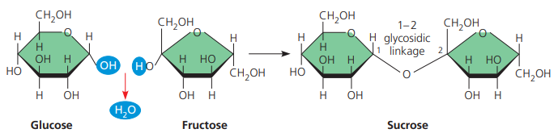
Formation of glycosidic linkage

Slide 5
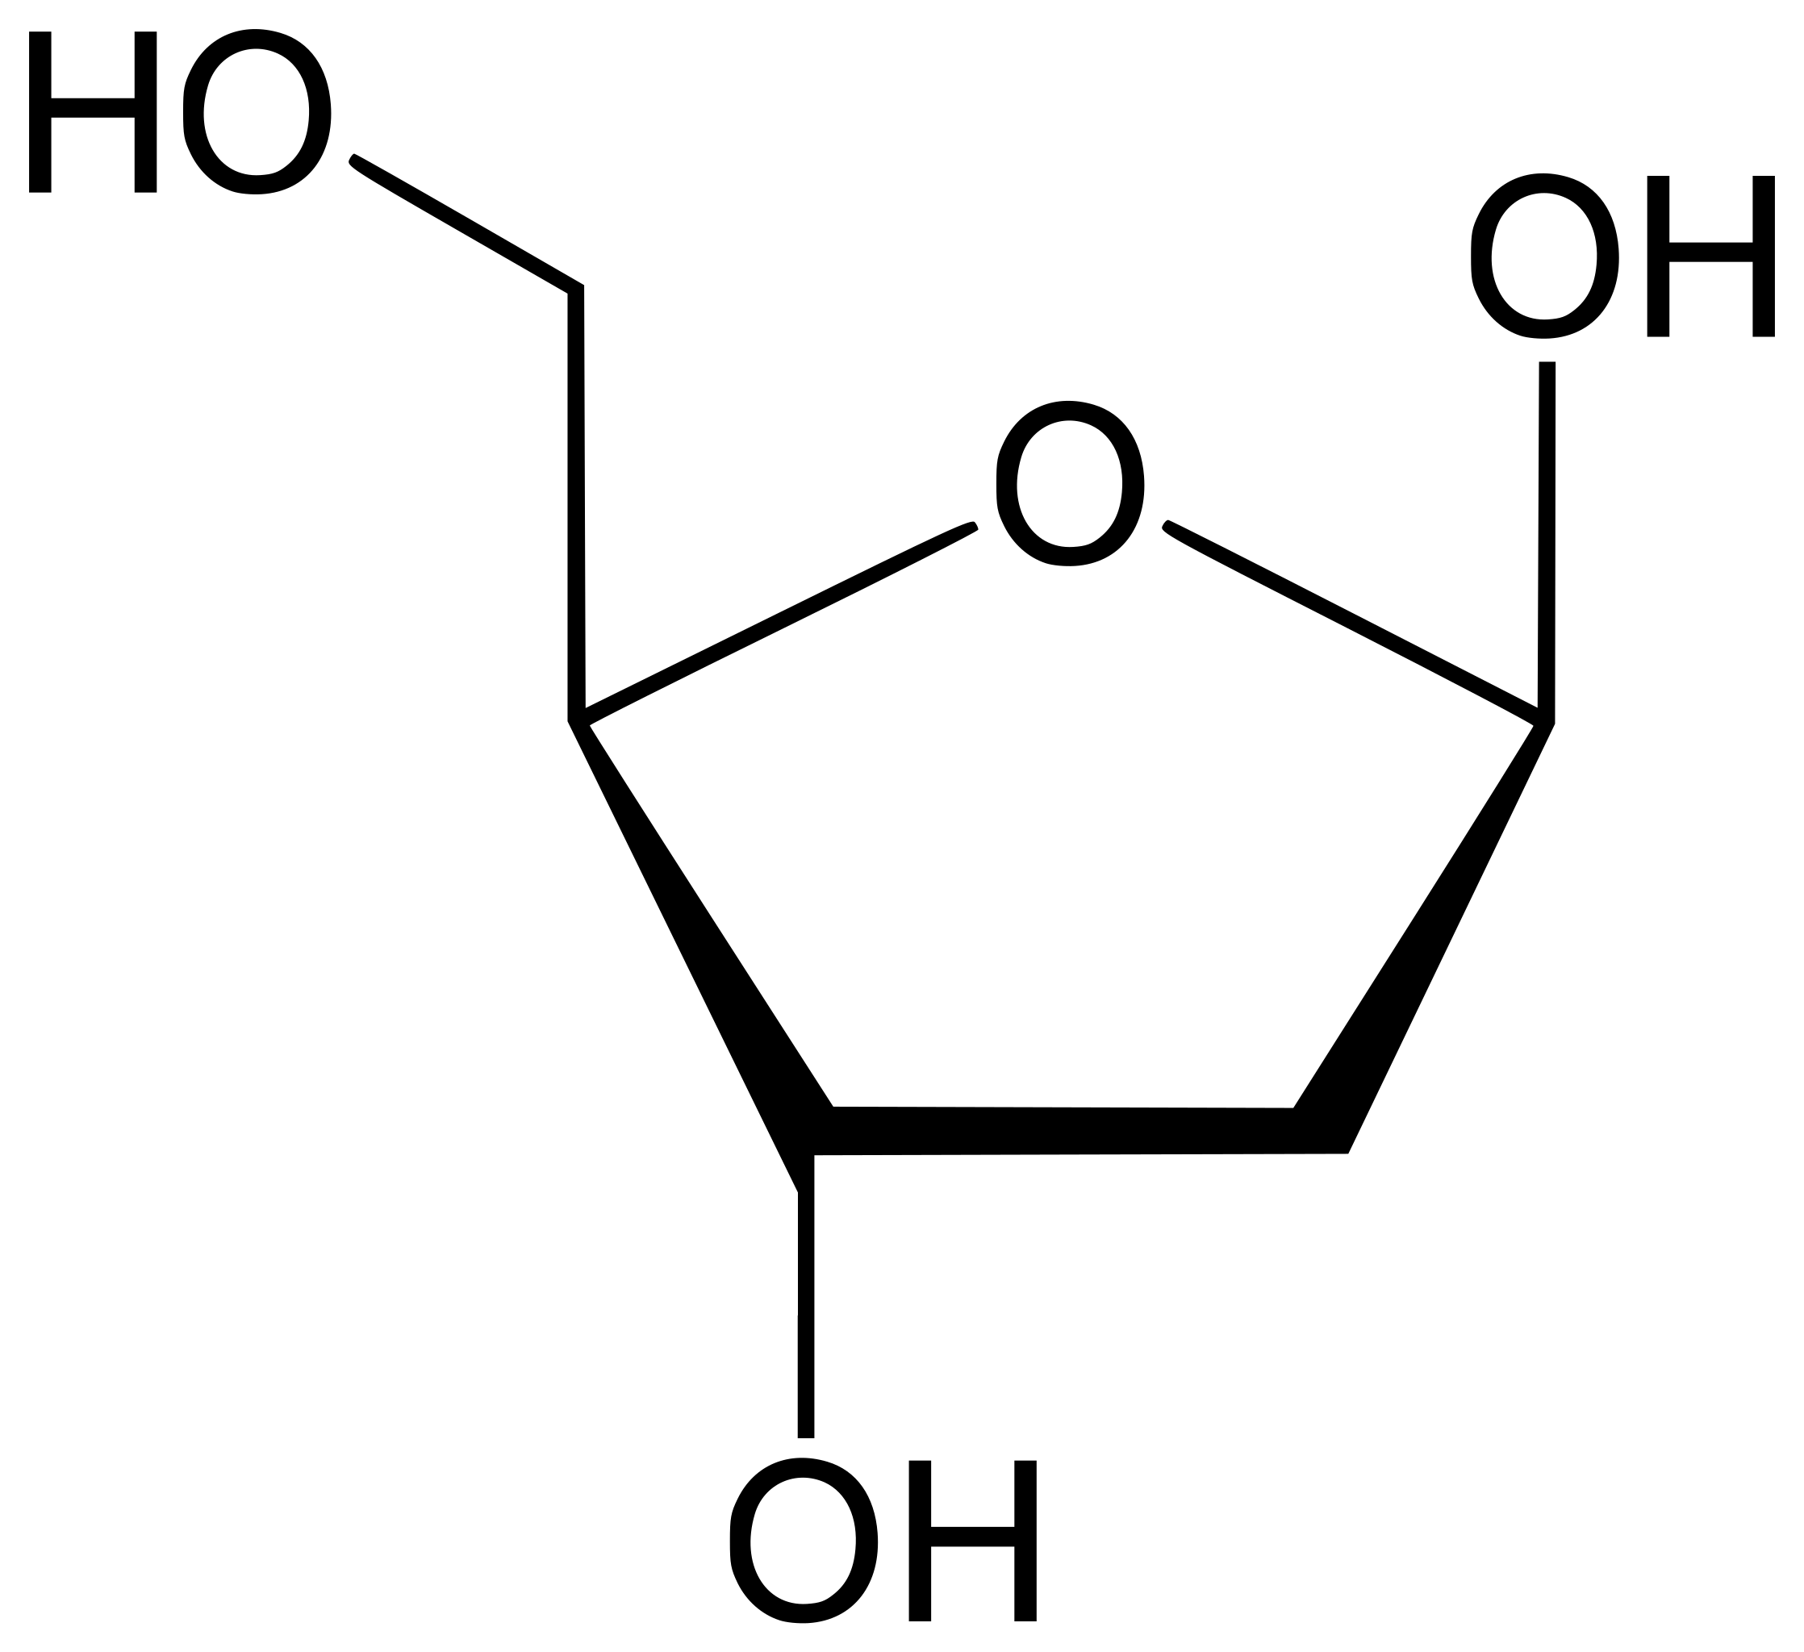
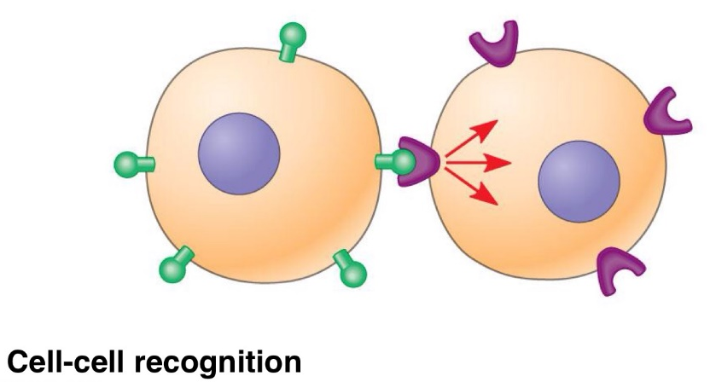
Functions of carbohydrates
Major functions for living systems
The principal function of carbohydrates, is to fuel cell activities with a ready source of energy.
Through photosynthesis plants make carbohydrates (glucose). Those carbohydrates form the foundation for almost all ecosystem’s energy source on Earth.
Deoxyribose is a building block of DNA.
Used in the synthesis of cell membrane & cell wall.
Carbohydrates are also involved in cell-cell recognition.
Macromolecular carbohydrates function as food reserves (glycogen in animals).
Deoxyribose

Slide 6
Principle
The purpose of this experiment is to investigate the presence of simple sugars in various food products.
Benedict's reagent is used for testing the presence of reducing sugars. This includes all monosaccharides and certain disaccharides, e.g., mannose, lactose and maltose.
Sucrose is disaccharide present in sugarcane; however, it is not a reducing sugar.
A reducing agent donates electrons during a redox reaction and is itself oxidized. The aldehyde functional group is the reducing agent in reducing sugars.
Reducing sugars have either an aldehyde functional group or have a ketone group in an open chain form, which can be converted into a carboxylic group.

Slide 7
Principle (cont.)
In hot alkaline solutions, reducing sugars reduce the blue Copper (II) ions to brick red Copper (I) oxide precipitate.
As the reaction proceeds, the color of the reaction mixture changes progressively from blue to green, yellow, orange and finally red.
The coloration developed and the amount of precipitate formed depends upon the amount of reducing sugars present. Hence, in most conditions, a sufficiently good estimation of the concentration of glucose and equivalent reducing sugars present in a sample can be obtained.
Water plus Benedict's reagent is a negative control for the sugar test. It demonstrates a negative test result (no sugar present). Carbohydrate sample plus Benedict's reagent is a positive control for the sugar test.

Slide 8
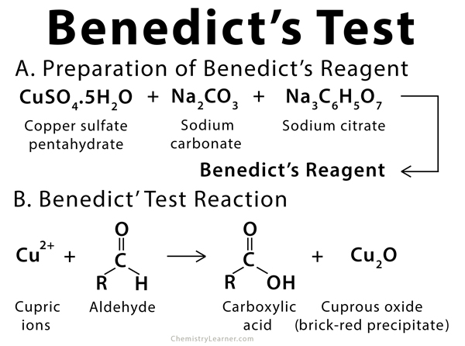
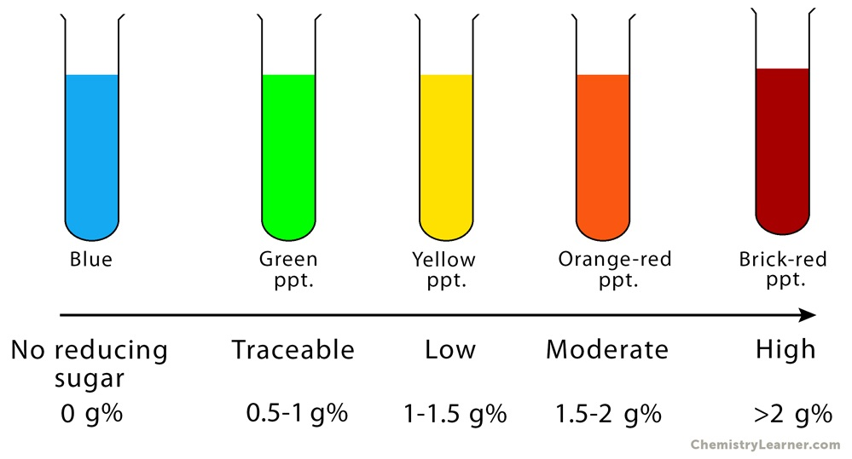

Slide 9
Methodology
Apparatus
Test tubes
Water bath
Spatula
Dropper
Hot water bath
Reagents/Solvents
Benedict’s reagent
Test sample (Apple juice)
Distilled water
Procedure
Take 1ml of the apple juice provided in a clean test tube.
Add 2ml of Benedict’s Solution to each test tube.
Leave the test tubes in the hot water bath and note your observation.
A positive test with Benedict's reagent is shown by a color change from clear blue to a brick-red precipitate.
To prepare a negative control, repeat steps 2-3 using distilled water instead of sample solution (i.e., Apple juice).

Slide 11
Benedict’s Test
https://www.youtube.com/watch?v=k1DOadNdPY4
https://www.youtube.com/watch?v=HxevnEdU9AI

Slide 12
Thank you!

